Slide 1

Industrial robot in harsh conditions
Kin Tung
Eren Pekgöz
Daniel Pedraglio O'Hara

Slide 2
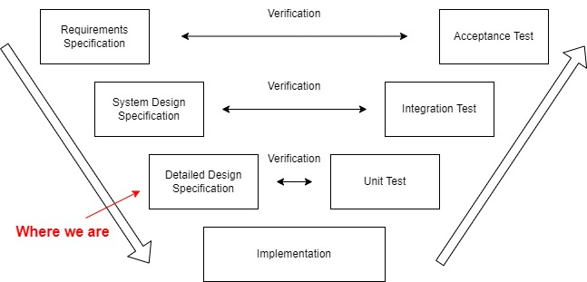
Current Project Status

Slide 3
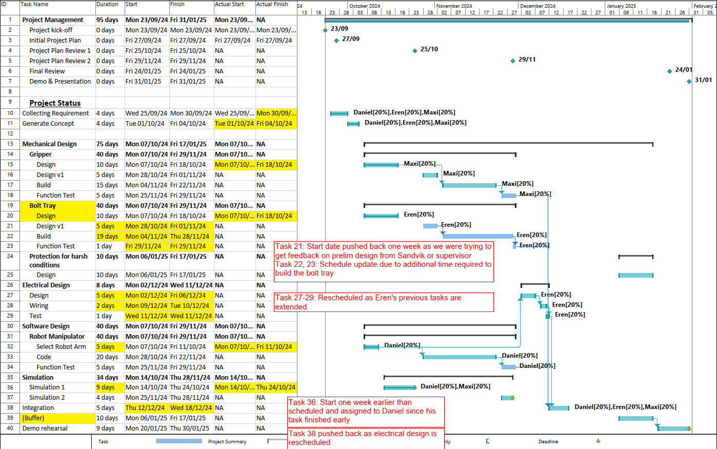
Project Schedule Update

Slide 4
Quick recap on requirements
Main Goal:
Design a robot to assemble rock bolts (Rebar + Steel Plate)
Environmental Conditions
Operating Environment: Indoor and outdoor.
Temperature Range: –40 to +40 °C.
Lighting Conditions: All lighting conditions, including direct sunlight and complete darkness.
Environmental factors: Dust, mud, moisture, snow and rain.
Specification of materials
Steel Plate:
Dimension: 200x200x8 mm
Weight: 2.51kg
Rebar:
Dimension: 25mm Dia x 3000mm long
Weight: 11.56kg
Steel Weight Calculator, Steel Express
https://www.steelexpress.co.uk/steel-weight-calculator.html

Slide 5
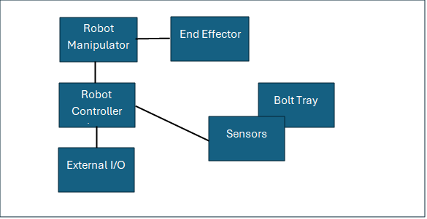
System Architecture

Slide 6
Process Flow
Step 1: Initialisation of system.
Step 2: Robot picks up plate.
Step 3: Robot places the plate on the bolt tray.
Step 4: Repeat step 2 and 3 until 4 plates are placed on the bolt tray.
Step 5: Robot places the rebar on the bolt tray.
Step 6: Robot pushes the rebar into the plate.
Step 7: Repeat step 5 – 6 until bolt tray has 4 assembled rebars.
Step 8: Robot returns to home position and stand by.

Slide 7
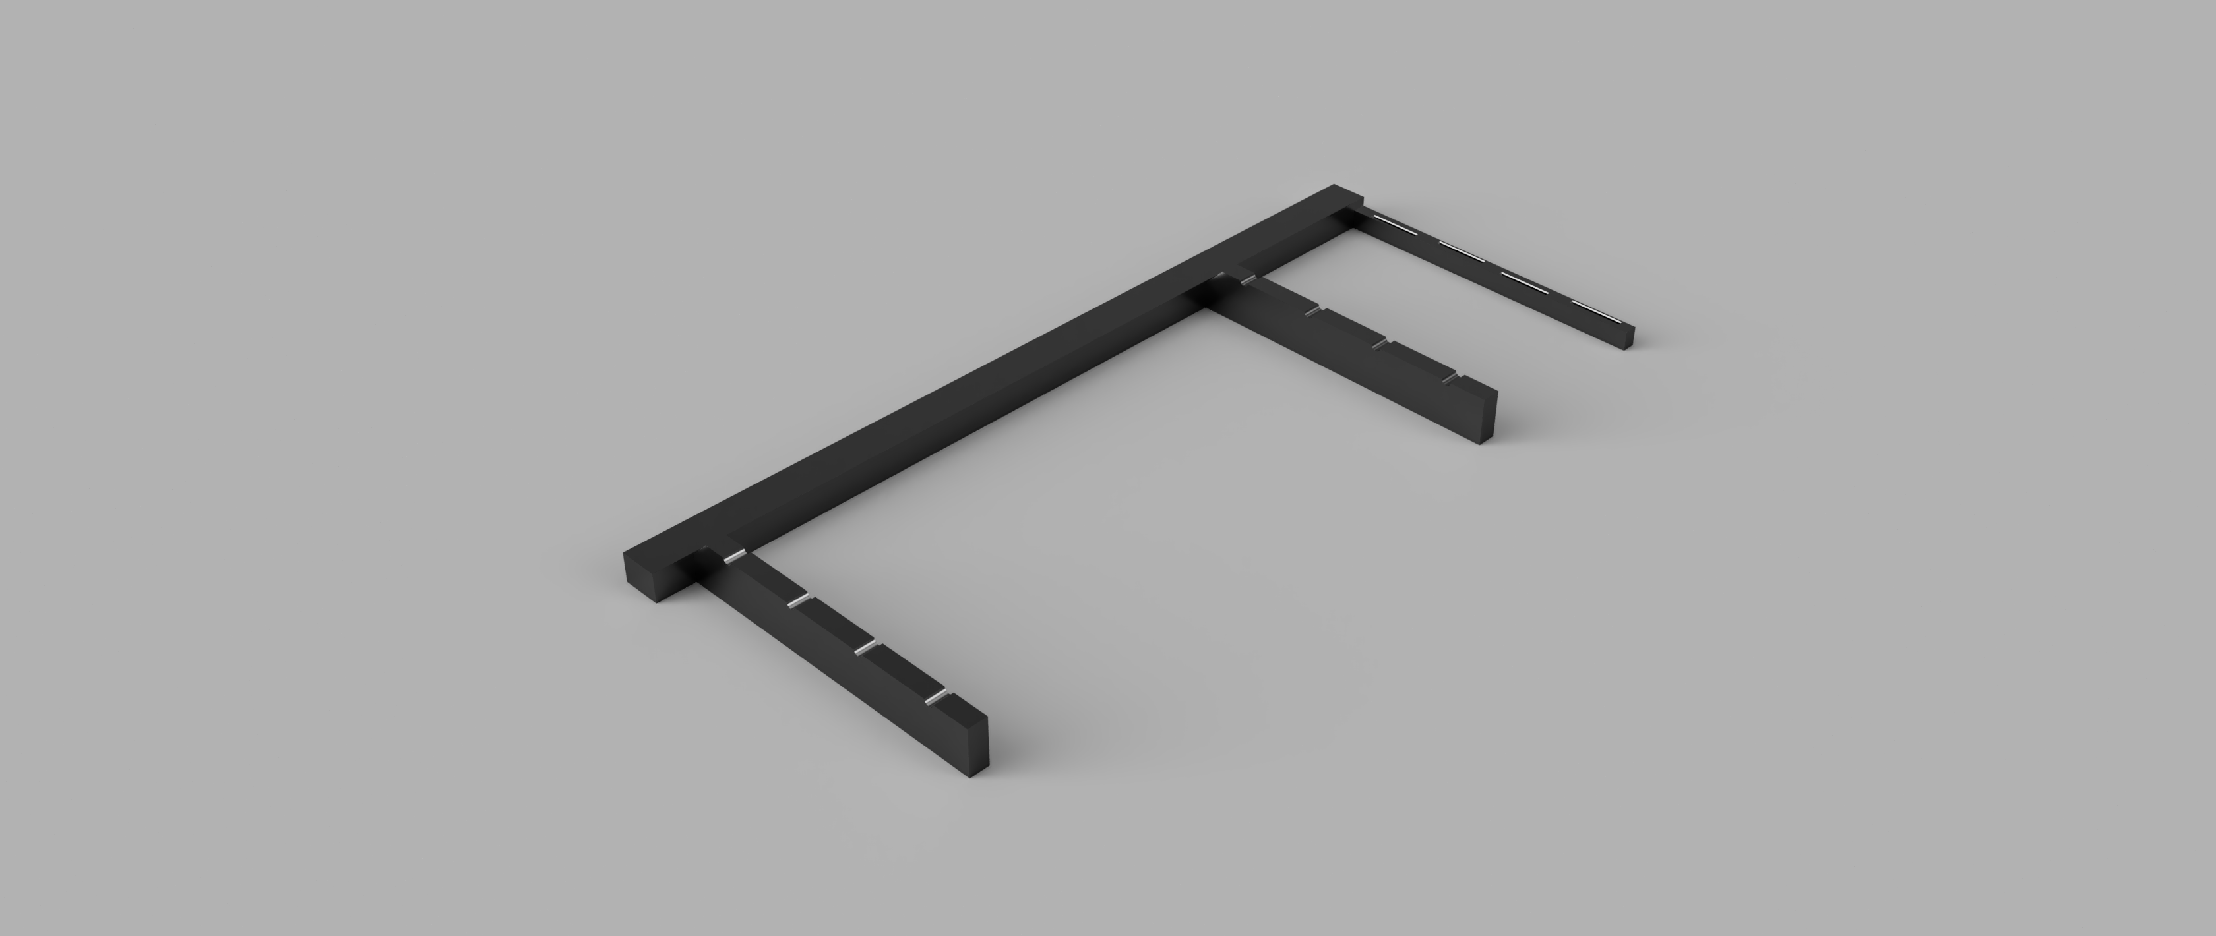
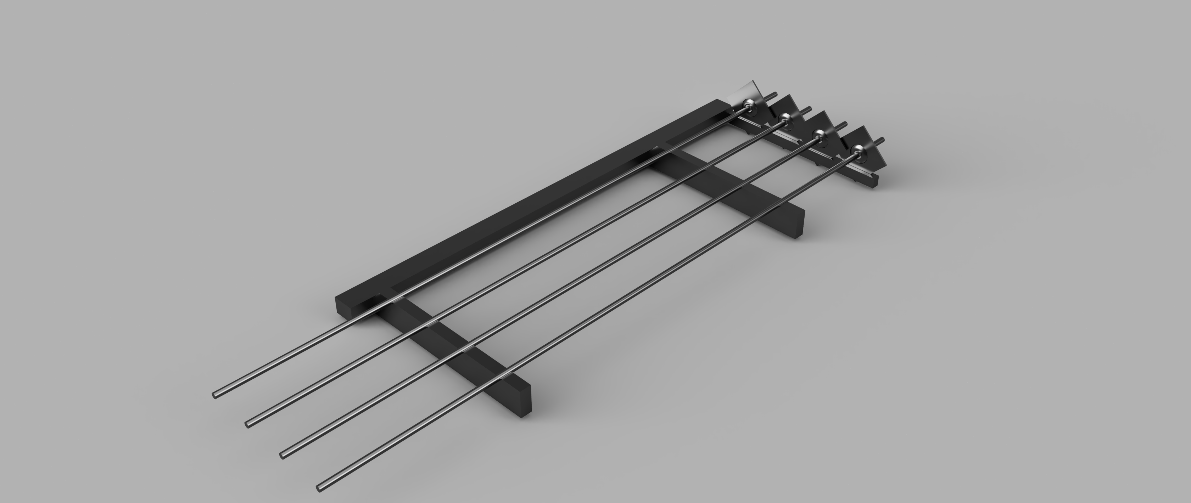
Bolt Tray
Material: Steel construction for durability and strength
Temperature Resistant: Can operate in both high and low temperature environments
No moving parts: Ensures reliability, reduces maintenance need
Fail-safe: Rebars remain secure even in power outages

Slide 8
Sensors on Bolt Tray
Sensor Type | Advantages | Disadvantages
Inductive Proximity Sensor | No moving parts, detects metal | Cannot detect non-metallic foreign objects
Limit Switch | Easy implementation, no calibration | Mechanical wear
Weight Sensor | High accuracy | Require a rather complex mechanical design of the bolt tray compared to other sensors
Laser Distance Sensor | 2 sensors are enough for the entire tray | Does not perform well with cylindrical or round objects

Slide 9
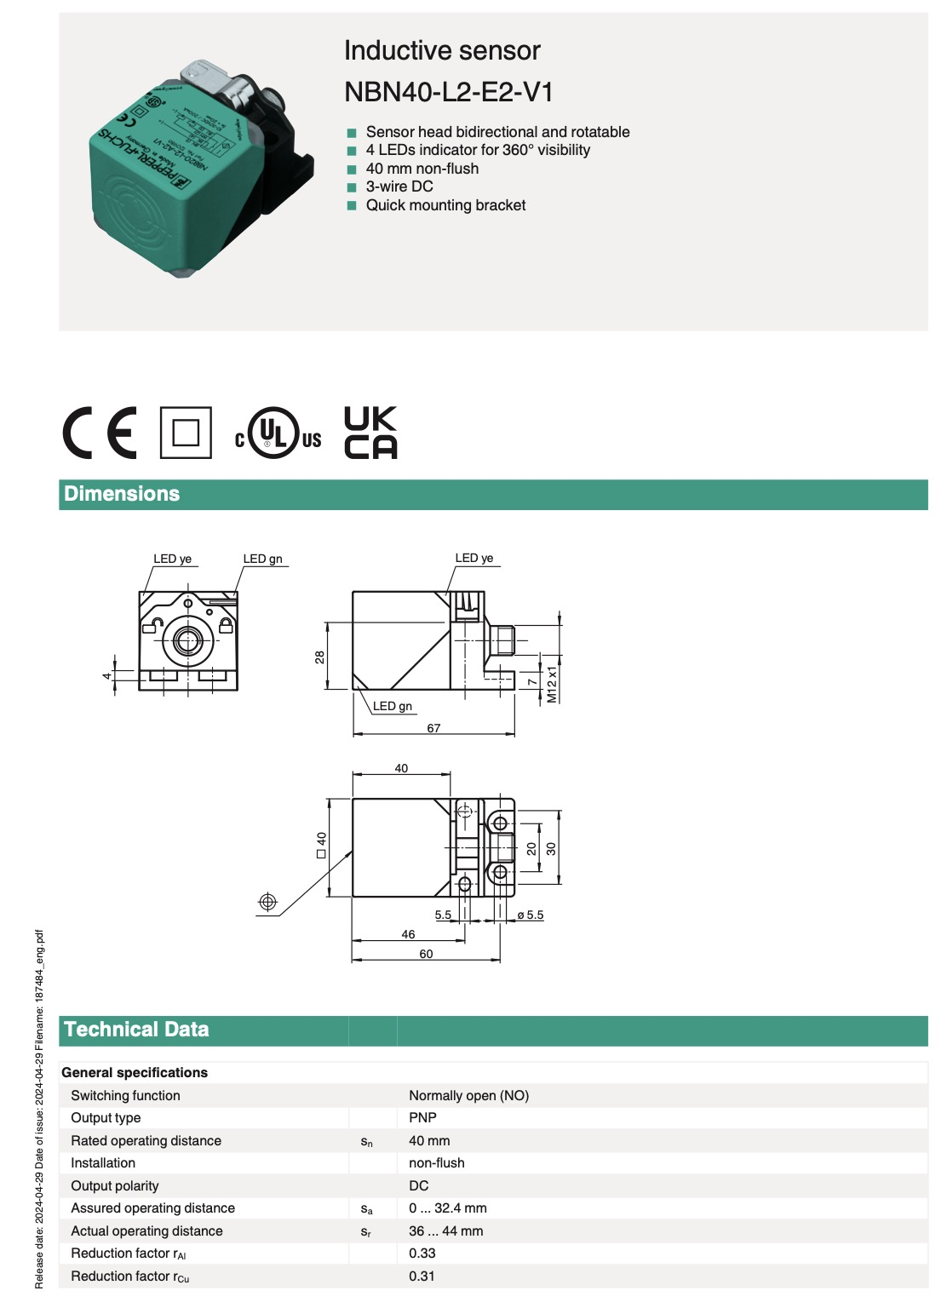
Proposed Sensor
Pepperl+Fuchs NBN40-L2-E2-V1:
Operating Distance 0...44mm
Normally Open Switch Mechanism
10-30V DC Operating Voltage

Slide 10
End Effector (1/3)
Functions:
Pick and plate rebar
Pick and plate metal plate
Push rebar into the plate

Slide 11
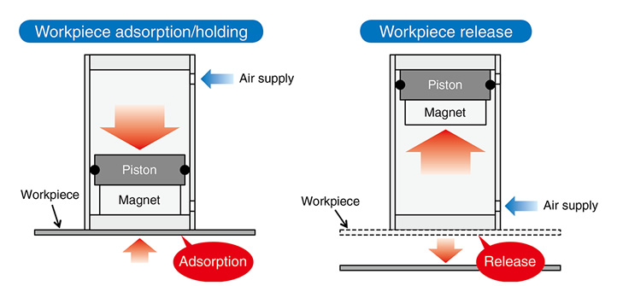
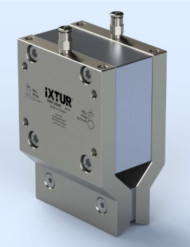
End Effector (2/3)
Magnetic Gripper
Magnetic force stronger in low temperature
No external moving parts
Lubrication not necessary => No frozen lubricant problem
No frozen joint problem in wet, sub-zero temperature
Pneumatic Magnetic Gripper
Permanent magnet
Fail-safe design
pneumatic pressure/power = off
no pneumatic pressure/no power = on
https://www.smcworld.com/newproducts/en/mhm/images/02b.jpg
IXTUR MRP-20NK
IP67
Lifting capacity with Safety Factor 3 = 13kg for solid round object (ø≥14mm)
IXTUR MRP-20NK Brochure
https://www.ixtur.com/wp-content/uploads/2023/08/Brochure_MRP-20NK_ENG112018.pdf

Slide 12
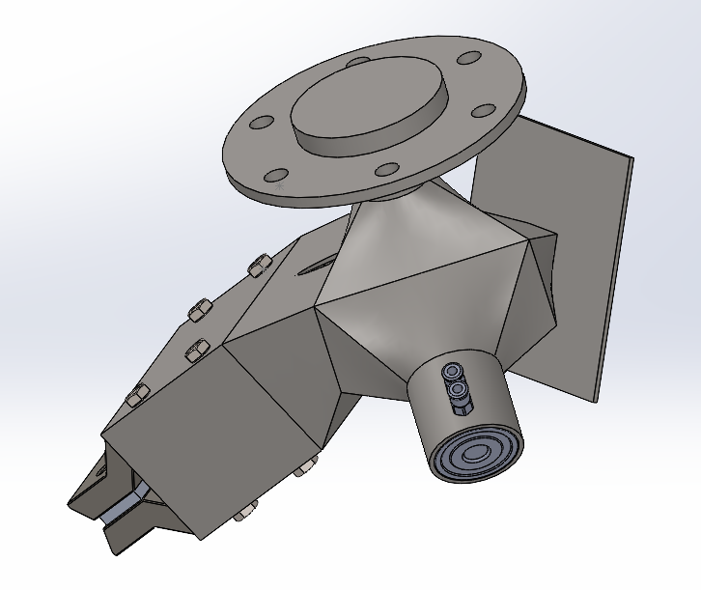
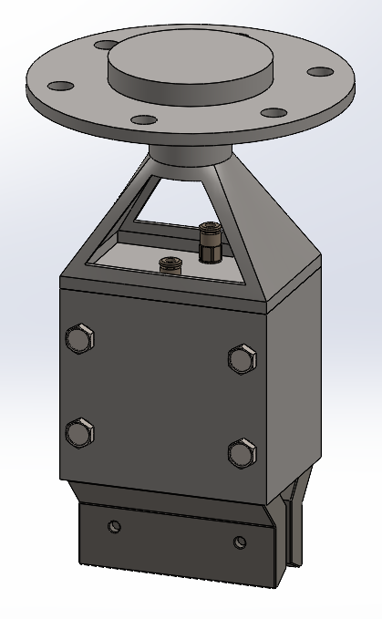
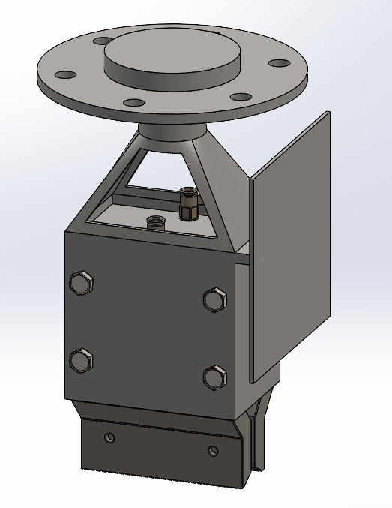
End Effector (3/3)
Rest of the end effector made of 304 stainless steel or other non-magnetic materials
Ver. 0
Ver. 0.1
Ver. 0.2

Slide 13
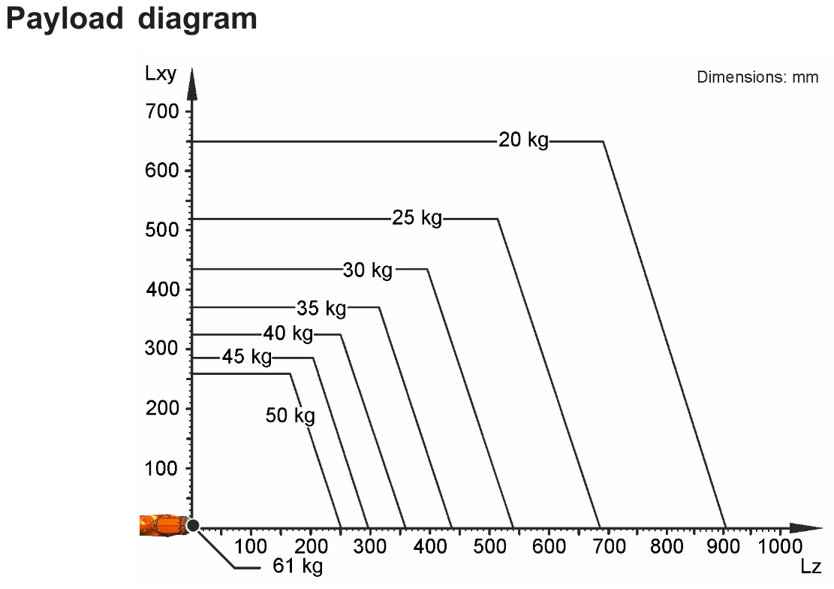
Robot Manipulator Requirements
Reach from edge of structure with end effector: 1920 mm.
Good work envelope for objects near and up to 400 mm below it.
Payload of 15,5 kg at 1155 mm.
Available in Visual Components.

Slide 14
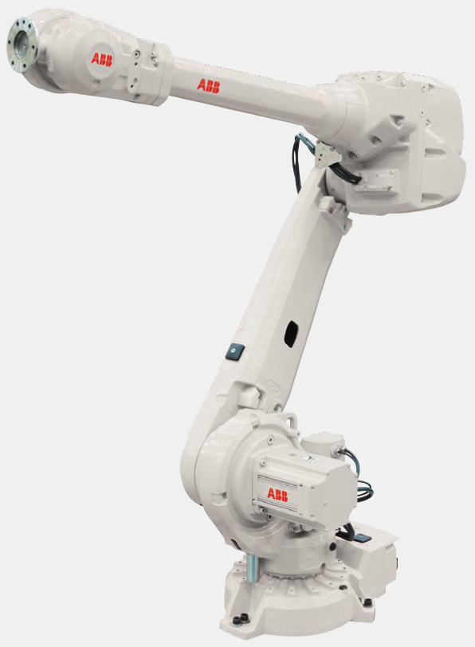
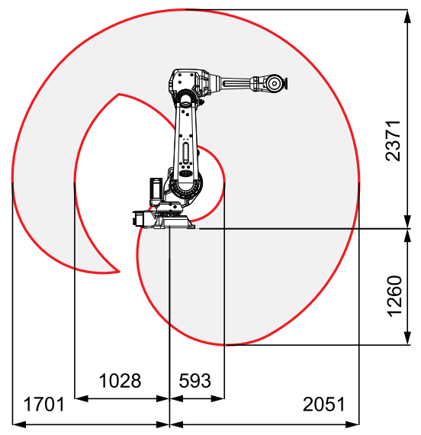
Robot Manipulator (1/2)
ABB IRB 4600-45/2.05
Reach: 2.05m
Payload: 45kg
IP67

Slide 15
Robot Manipulator (2/2)
Electrical connection: 200-600 V, 50-60 Hz
Weight: 445kg
Operating temperature: 5° to 45° C
Will require heating in colder environments
Humidity: max 95%

Slide 16
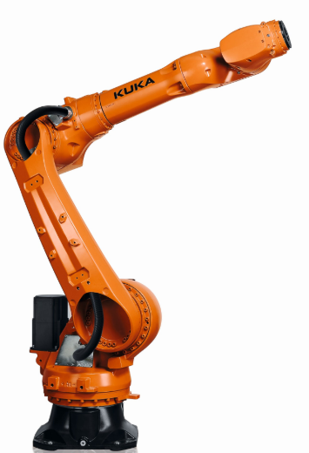
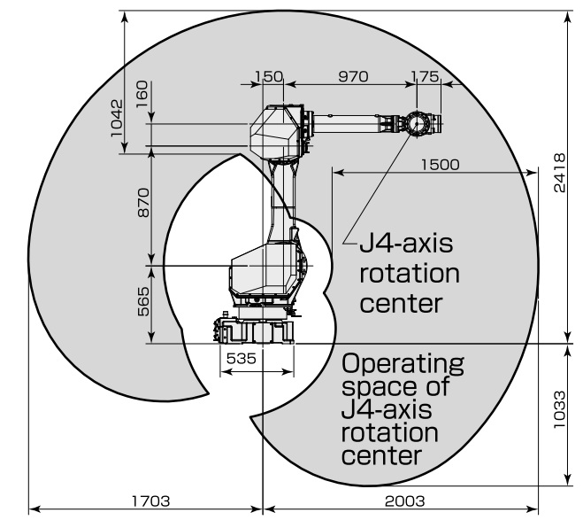
Alternative Robot Manipulators
Kuka KR 50 R2100
5 kg more payload, 51mm more reach, operates from 0° to 55° C.
Almost 20% heavier.
Fanuc M-710/50-20C-5X
5kg more payload, operates from 0° to 45° C.
20% heavier, less humidity allowed, worse work envelope due to 5 joints

Slide 17
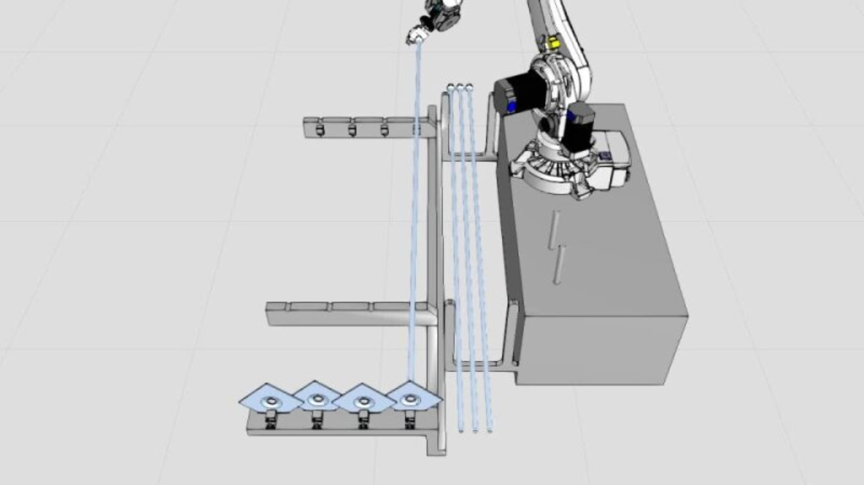
Simulation

Slide 18
From Now to Next Progress Review
Design v1, build and functional test for end effector and bolt tray*
Coding robot manipulator*
*If we manage to get in touch with our supervisor or Sandvik's representative to discuss prototyping

Slide 19
Q&A

Slide 20
Thank you!

